Slide 1


Project Presentation (KCS 753) Road Lane Line Detection
KIET Group of Institutions, Ghaziabad
(An ISO – 9001: 2008 Certified & ‘A+’ Grade accredited Institution by NAAC)
Guide Name: Mr. Vivek Kumar Sharma
Project Members Name with Roll Number & Section
1.Swati Mishra (2100290120173)
2.Swapna Gupta (2100290120172)
3.Suryansh Mishra (2100290120171)
4.Shivangi Singhal (2100290120158)

Slide 2
Problem Statement
In modern transportation systems, driver assistance and autonomous vehicles require reliable identification of road lane lines to maintain safe and accurate lane positioning. Manual driving often suffers from human error due to fatigue or poor visibility. The challenge is to develop a system that can detect lane lines from images or video streams in real time, regardless of noise, shadows, and lighting conditions.

Slide 3
Objectives
To implement a system that detects road lane lines from both images and videos using computer vision techniques.
To enhance visibility of lane lines using color filtering and edge detection.
To apply Region of Interest (ROI) masking to ignore irrelevant parts of the frame.
To use the Hough Line Transform to detect and draw straight lines representing road lanes.
To visualize the detected lines over the original input for better interpretability.

Slide 4
Technology Used
Programming Language: Python
Libraries & Frameworks: OpenCV, NumPy, Matplotlib.
Techniques: Gaussian Blurring, HSV Filtering, Canny Edge Detection, Hough Line Transform.
Input Formats: Static image, Video file.

Slide 5
Literature Survey
Paper Title: Lane Detection and Tracking for Driver Assistance: A Review
Author(s): Y. Wang, E. K. Teoh, D. Shen Journal Name: IEE Proceedings - Intelligent Transport Systems Year of Publishing: 2004 Summary: This paper presents a comprehensive review of lane detection and tracking algorithms used in driver assistance systems. It highlights various techniques including edge detection, Hough Transform, and model fitting. The authors also discuss challenges like occlusions, shadows, and variable lighting. The paper strongly supports the use of Canny edge detection combined with Hough Transform, which aligns with the approach used in this project.

Slide 6
Literature Survey
Paper Title: Real-Time Lane Detection and Tracking System Based on a Single Camera
Author(s): Y. Jung, Y. Cho, and H. Myung Journal Name: Sensors (MDPI) Year of Publishing: 2013 Summary: This paper proposes a real-time lane detection system using a single camera and standard computer vision techniques. It uses grayscale conversion, Gaussian filtering, edge detection, and the Hough Transform. The authors address real-time constraints and accuracy challenges. Their approach influenced our system’s pipeline structure, especially the ROI masking and Hough Line detection.

Slide 7
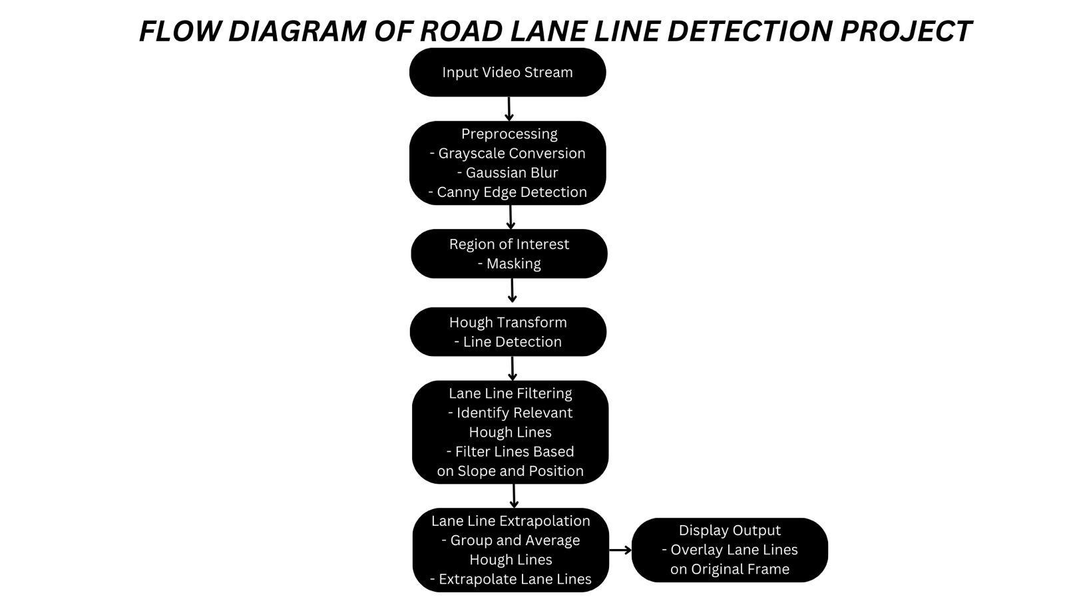
Workflow Diagram
Diagram to show the process involved in the project.

Slide 8
Patent Status
Submitted.

Slide 9
Research Paper Status
Submitted.

Slide 10
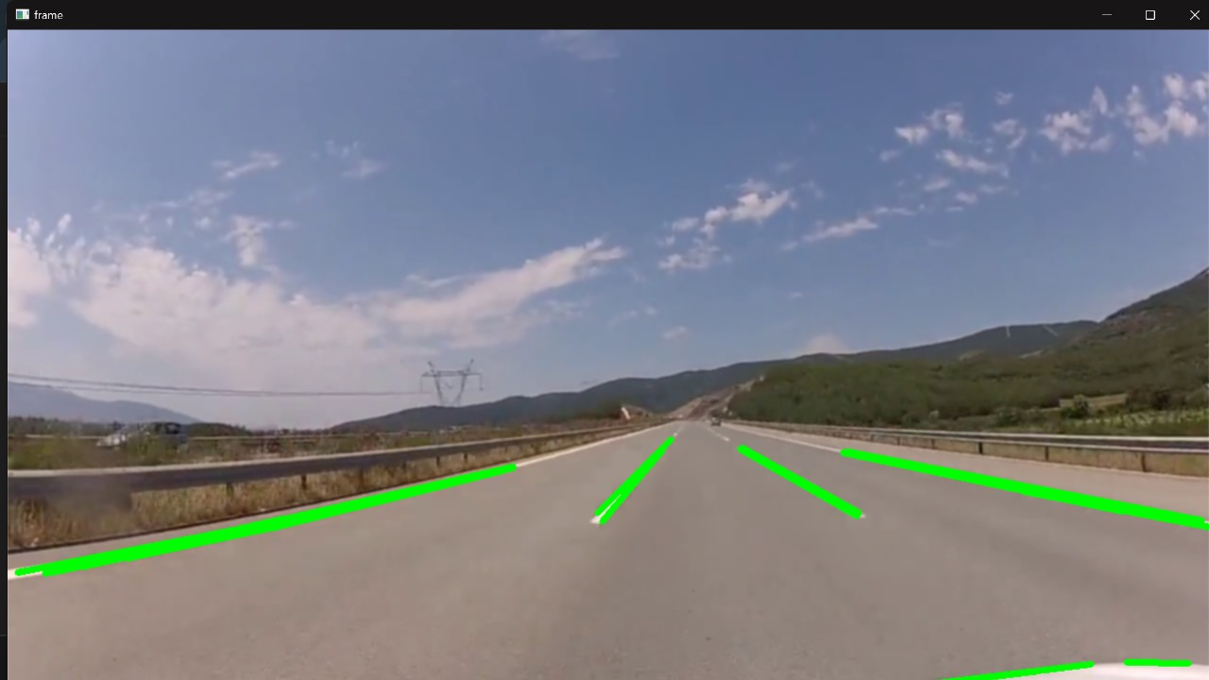
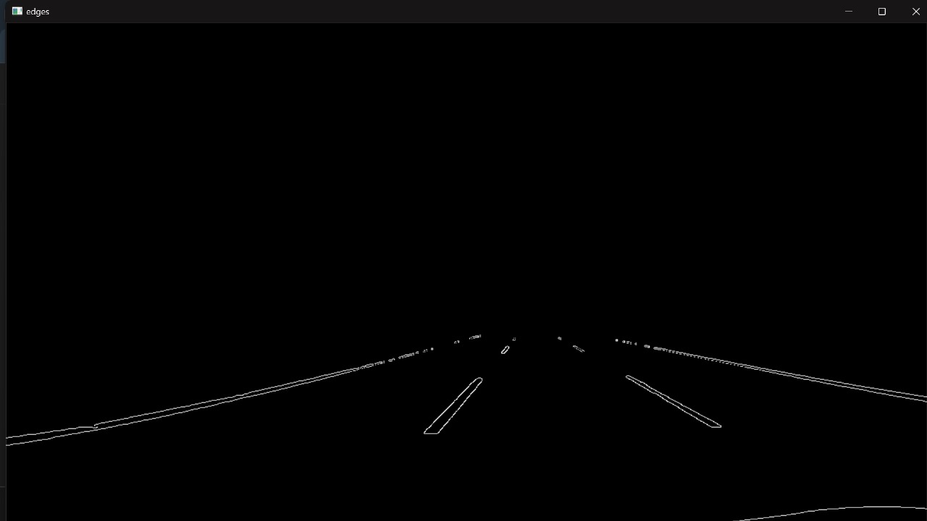
Project Status
Completed 100%.
Fig. 1: Real time road lane line detection
Fig. 2: Gray scale image

Slide 11
SDG 3 – Good Health and Well-being
By assisting in reducing traffic accidents through autonomous vehicle support and driver assistance, the system contributes to safer roads and improved public health outcomes.

Slide 12
SDG 9 – Industry, Innovation, and Infrastructure
Incorporates cutting-edge technologies such as AI, Computer Vision, and Deep Learning to enhance intelligent transport infrastructure and foster innovation in the mobility sector.

Slide 13
SDG 11 – Sustainable Cities and Communities
Smart transportation systems powered by lane detection can reduce congestion, support traffic automation, and enable safer, more sustainable urban environments.

Slide 14
SDG 13 – Climate Action
Supports development of autonomous electric vehicles that could reduce emissions, contributing indirectly to climate action.

Slide 15
References
T. M. Hoang, P. H. Nguyen, N. Q. Truong, Y. W. Lee, and K. R. Park, “Deep RetinaNet-Based Detection and Classification of Road Markings by Visible Light Camera Sensors,” Sensors, vol. 19, no. 2, p. 281, 2019.MDPI
A. A. Mamun, E. P. Ping, J. Hossen, A. Tahabilder, and B. Jahan, “A Comprehensive Review on Lane Marking Detection Using Deep Neural Networks,” Sensors, vol. 22, no. 19, p. 7682, 2022.MDPI
F. Pizzati, M. Allodi, A. Barrera, and F. García, “Lane Detection and Classification using Cascaded CNNs,” arXiv preprint arXiv:1907.01294, 2019.arXiv
L. Liu, X. Chen, S. Zhu, and P. Tan, “CondLaneNet: a Top-to-down Lane Detection Framework Based on Conditional Convolution,” arXiv preprint arXiv:2105.05003, 2021.arXiv
S. Lee et al., “VPGNet: Vanishing Point Guided Network for Lane and Road Marking Detection and Recognition,” arXiv preprint arXiv:1710.06288, 2017.arXiv+1MDPI+1
T. Arnall, “Robot Readable World,” Wired, 2012.

